Slide 1
CDS HIV Connectathon September 2022

Slide 2
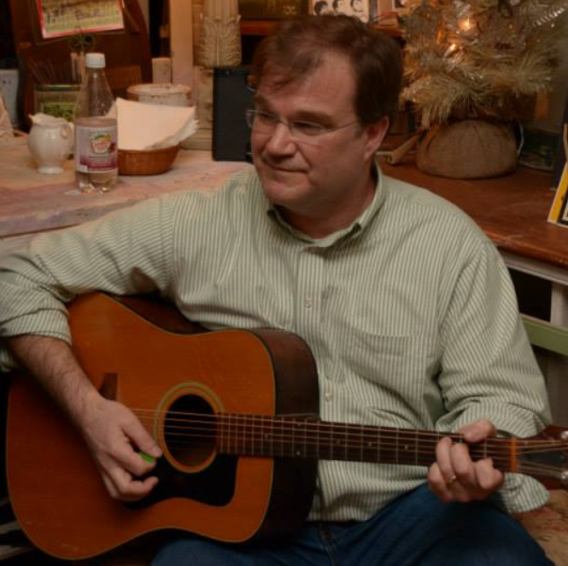
Who am I?
John E. Gresh (John, he/him)
Consultant, National Association of Community Health Centers (NACHC)
25 years experience in research informatics focused on Java/Database application development for research and health care
Regular at the local hootenanny

Slide 3
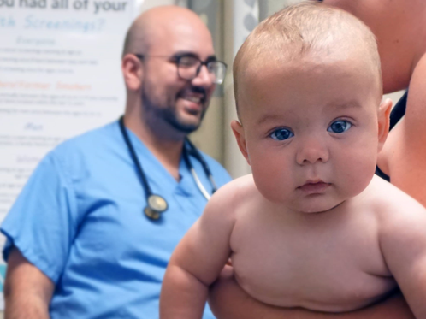


Who Is NACHC?
The NACHC Mission: The National Association of Community Health Centers (NACHC) was founded in 1971 to promote efficient, high quality, comprehensive health care that is accessible, culturally and linguistically competent, community directed, and patient centered for all

Slide 4
CDS HIV Connectathon July 2022 Goals
Define options for implementation of Clinical Decision Support and Questionnaires/Surveys using HL7 FHIR Questionnaire Resources, Implementation Guides, and Best Practices for HIV specifically and for Surveys in general moving forward
For the current state
For future state by the end of 2022
For future state by the end of 2023
The goal is not to define the solution, but to define the current state and start the process of creating a road map to future solutions
Present the current state options for creating functional surveys from the CDC HIV implementation guide specifically and for creating functional surveys from HL7 FHIR Implementation Guides in general
Present a working solution for the CDC HIV survey created from the current CDC HIV Implementation Guide
Participants will gain an understanding of how the HL7 CDC HIV Implementation Guide can currently be used to create a functional SMART o FHIR Application
Participants will be able to connect to and exercise an existing Implementation of a SMART on FHIR Application create from the current HL7 CDC HIV Implementation Guide

Slide 5
HL7 Clinical Decision Support and Questionnaire Options for Implementation: How
Use Implementation Guide as a “Blue Print”
Current State
Requires the most effort
Additional Functionality requires additional custom coding
Could be considered “technical debt” and need to be replaced with future sate solutions
Use existing open source solution to implement questionnaire
Not currently available, but on the road map
Use existing open source solution to implement questionnaire with automated clinical decision support
Fully feature solution that maximizes value of the work done to define existing resources
Not currently available, but on the road map

Slide 6
HL7 Clinical Decision Support and Questionnaire Options for Implementation: What
Open Source
Open source solutions exist for the creation of functional Surveys that can be launched from an EMR using SMART on FHIR
Proprietary
There are also a number of vendors who are willing to get paid to provide a solution for creating surveys using their own proprietary technology

Slide 7
HL7 Clinical Decision Support and Questionnaire Options for Implementation: Who/Where
Centralized
For each Survey, a single SMART on FHIR application is created and hosted centrally
Reuse (multi-tenant)
Consistency
Lowered Cost
Etc.
Distributed
Each partner develops their own solution
No reuse
Inconsistent
Additional Cost
Etc.

Slide 8
HL7 Clinical Decision Support and Questionnaire Connectathon Activities
How to implement HIV Questionnaire from HIV-CDS resources as “Blueprint”
Implement SMART on FHIR application
Authenticate to EMR FHIR Server
Read/Write Patient data
Render UX for questionnaire using HIV-CDS resources
Submit Questionnaire to EMR

Slide 9
HL7 Clinical Decision Support and Questionnaire Options for Implementation: Resources
How to implement HIV Questionnaire from HIV-CDS resources as “Blueprint”
CDS-HIV Questionnaire resources are here
Github: https://github.com/cqframework/hiv-cds
Implementation instructions: https://github.com/cqframework/hiv-cds/blob/master/input/pagecontent/getting-started.md
LHC-Forms (Lforms) is here
Github: https://github.com/lhncbc/lforms-fhir-app
Demo: https://lhcforms.nlm.nih.gov/sdc
SMART on FHIR Demos and Implementation of HIV Questionnaire are here
https://nachc-cad.github.io/hiv-cds/pages/navbar/resources/smart-on-fhir-examples/SmartOnFhirExamples.html
https://github.com/greshje/lforms-demo
Run locally here
http://localhost:8080/lforms-examples/pages/questionnaire/hiv-cds/HivCdsQuestionnaire.html
Run from SMART on FHIR EMR launch here:
https://launch.smarthealthit.org/
http://localhost:8080/lforms-examples/pages/questionnaire/hiv-cds/smart/launch.html

Slide 10
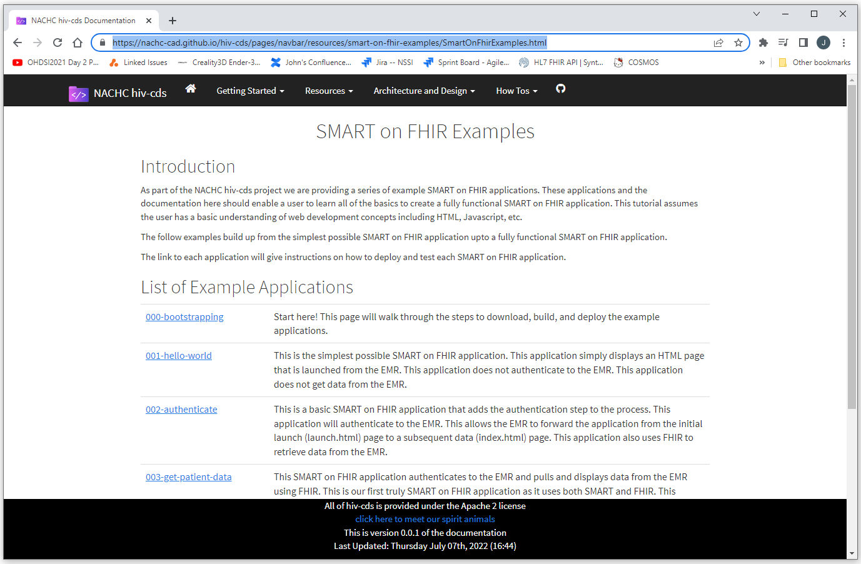
SMART on FHIR Examples are here:
https://nachc-cad.github.io/hiv-cds/pages/navbar/resources/smart-on-fhir-examples/SmartOnFhirExamples.html

Slide 11
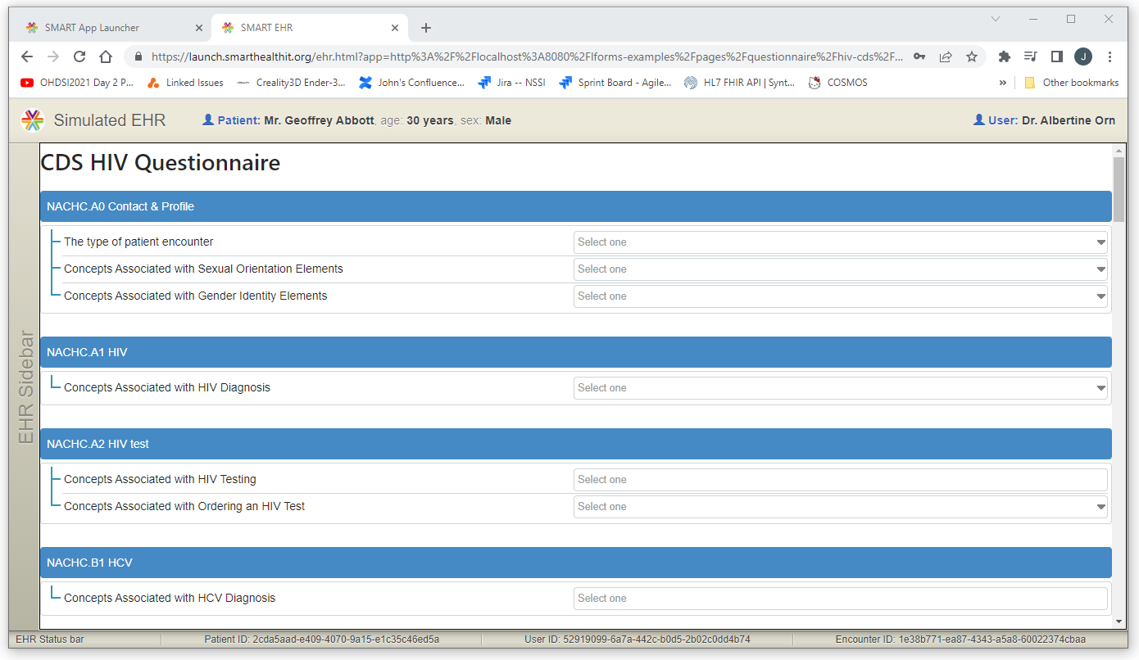
HIV Questionnaire Rendered Using LHC-Forms (LForms) is here:
https://github.com/greshje/lforms-demo

Slide 12


